Slide 1
Capstone Project 3
Sentiment Analysis : Predicting sentiment of COVID19 tweets
Team Members
Aayush Kumar
Sumeet Agrawal
Shafil Ahamed

Slide 2
Contents
Problem Statement
Data Summary
Missing Values
Exploratory Data Analysis
Feature Engineering
Model Training
Results from Model
Challenges
Conclusion

Slide 3
Problem Statement
There is lot of misuse of social media platform, in which Twitter is one of them. Many user intentionally send negative tweets to create fear and negativity in the society or environment.
Our objective is to build a machine learning model to predict the sentiment of COVID-19 tweets. If tweets had been found negative then tweets would be removed from twitter.

Slide 4
Data Summary
We were provided with Coronavirus_Tweets.csv dataset.
Shape of the dataset is (41157,6).
Important features of dataset are-
1) Username
2) Screen Name
3) Tweet at
4) Location
5) Original Tweet
6) Sentiment

Slide 5
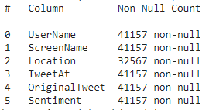
Looking for Missing Values
On looking the dataset we found that feature ‘Location’ has missing values.
We don’t have any idea about that tweets whose location is missing.
So we have ap option to fill that missing values by Mode or another way is to fill randomly.
Also, one way is to drop those columns to get rid off missing values.

Slide 6
EXPLORATORY DATA ANALYSIS

Slide 7
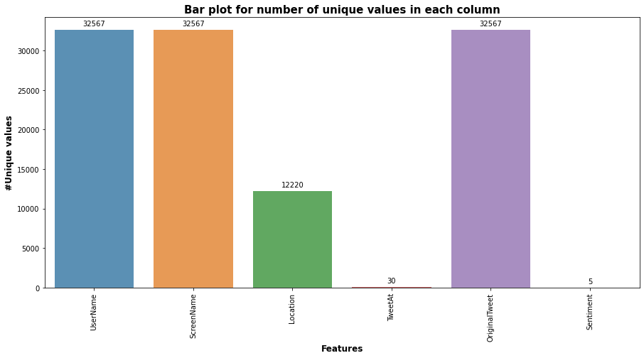
Number of Unique features

Slide 8
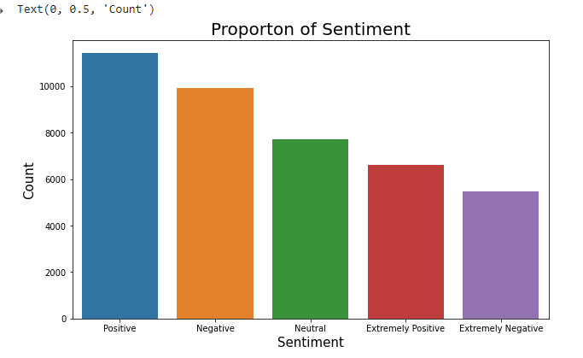
Sentiment Count

Slide 9
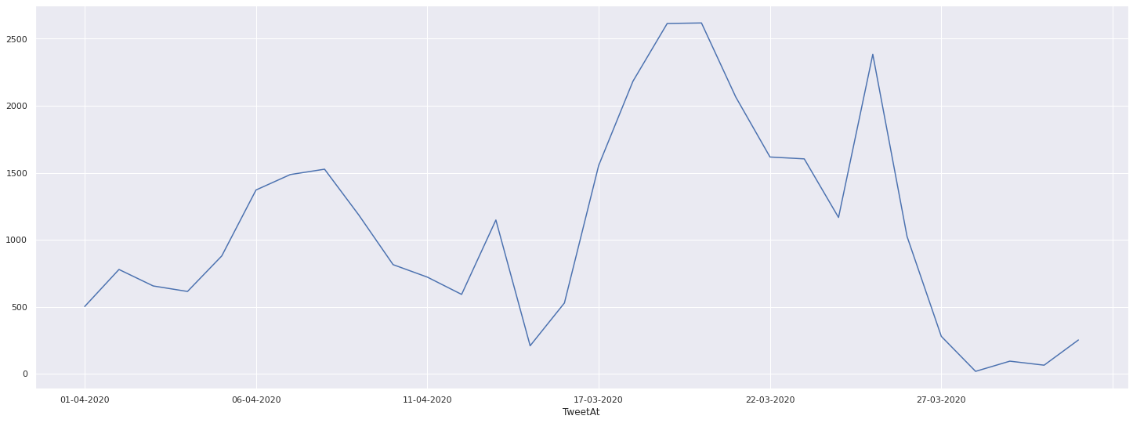
Plot between Number of Tweets and TweetAt

Slide 10
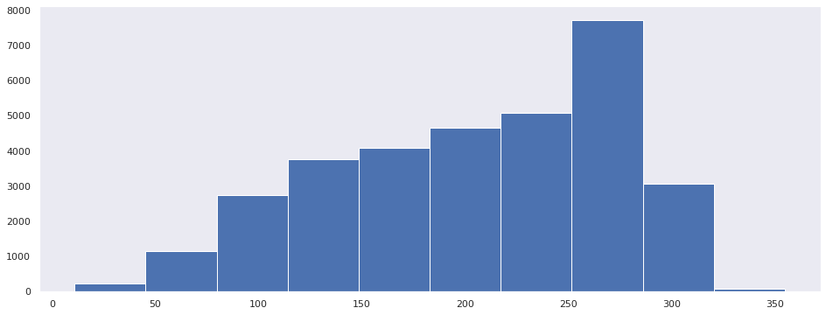
Number of Tweets according to the length

Slide 11
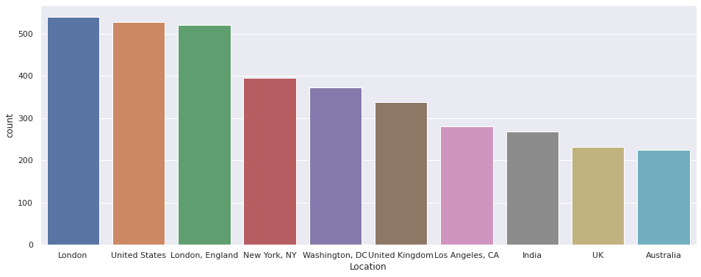
Tweets from Top 10 Location

Slide 12
Feature Engineering

Slide 13

Word Cloud

Slide 14
Sentiments Analysis
There are 5 different sentiments are present in dataset.
They are :–
1) Neutral
2) Positive
3) Extremely Positive
4) Negative
5) Extremely Negative
To make problem simpler we changed the sentiments into 3 different types.
We merged Extremely positive and Positive into one and Extremely Negative and Negative into another.
Now we have Sentiments are –
1) Neutral
2) Positive
3) Negative

Slide 15
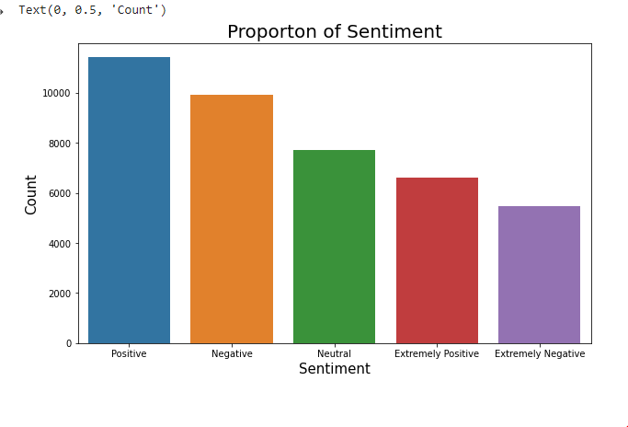
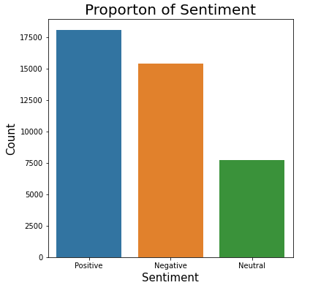
Sentiments Count plot
Original Sentiment count
After merging Sentiments

Slide 16
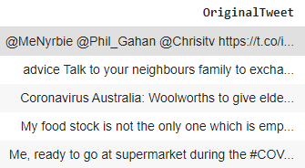
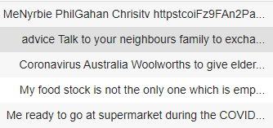
Data Cleaning
By looking tweets we can found that there are lots of punctuation, Stopwords.
So, we need to clean this as they won’t play any major role in Sentiment analysis.
First Step :-
Remove punctuations.

Slide 17
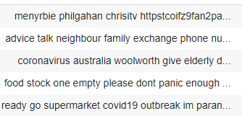
Data Cleaning….Cont.
Second Step :-
Remove Stopwords.
(Stopwords are the English
words which does not add
much meaning to a
sentence. For example, the
words like the, he, have etc.)

Slide 18
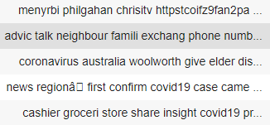
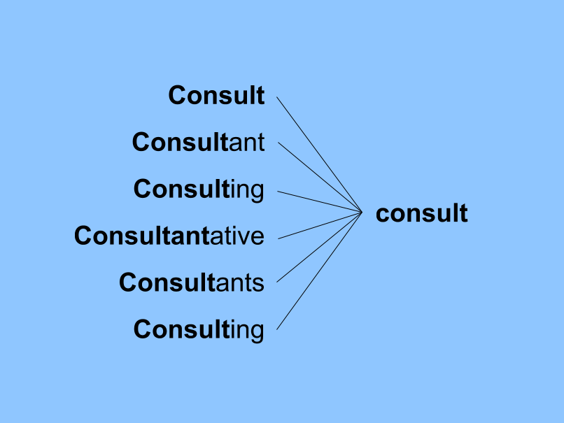
Data Cleaning….Cont.
Third Step :-
Apply Stemming.
(Stemming is basically
removing the suffix from
a word and reduce it to
its root word sentence.
Example -

Slide 19
Model Formulation

Slide 20
Model Formulation
Sr. No. | Model | Dataset Shape | Algorithm Used
01 | Independent Feature – ‘OriginalTweet’ Dependent feature – ‘Sentiment’ | (32567,6) | Logistic Regression Passive Aggressive Classifier, Stochastic Gradient Descent Classifier, Support Vector machine Random Forest

Slide 21
Model Formulation
Sr. No. | Algorithm used | Accuracy | Precision | Recall
01 | Logistic Regression | 0.7752 | 0.7887 | 0.7752
02 | Passive Aggressive Classifier | 0.7396 | 0.7474 | 0.7396
03 | Stochastic Gradient Descent Classifier | 0.7692 | 0.8050 | 0.7692
04 | Support Vector machine | 0.7692 | 0.8050 | 0.7692
05 | Random Forest | 0.7359 | 0.7410 | 0.7359

Slide 22
Challenges and Conclusions

Slide 23
Challenges
Removing the missing values
Cleaning the Original tweets
Selection of best model

Slide 24
Conclusions
Original Dataset contains 6 columns and 41157 rows.
‘Location’ column contains approx. 21% of Null values.
The columns such as “UserName” and “ScreenName” does not give any meaningful insights for our analysis.
There are five types of sentiments- Extremely Negative, Negative, Neutral, Positive and Extremely Positive. So, we merged Extremely Positive with positive and Extremely Negative with Negative.
All tweets data collected from months March and April 2020
Most of the tweets came from London followed by U.S.

Slide 25
THANK YOU

